Slide 1


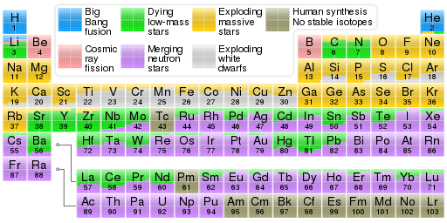
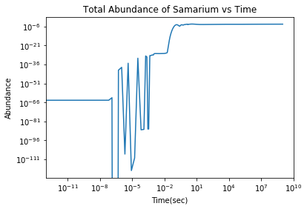
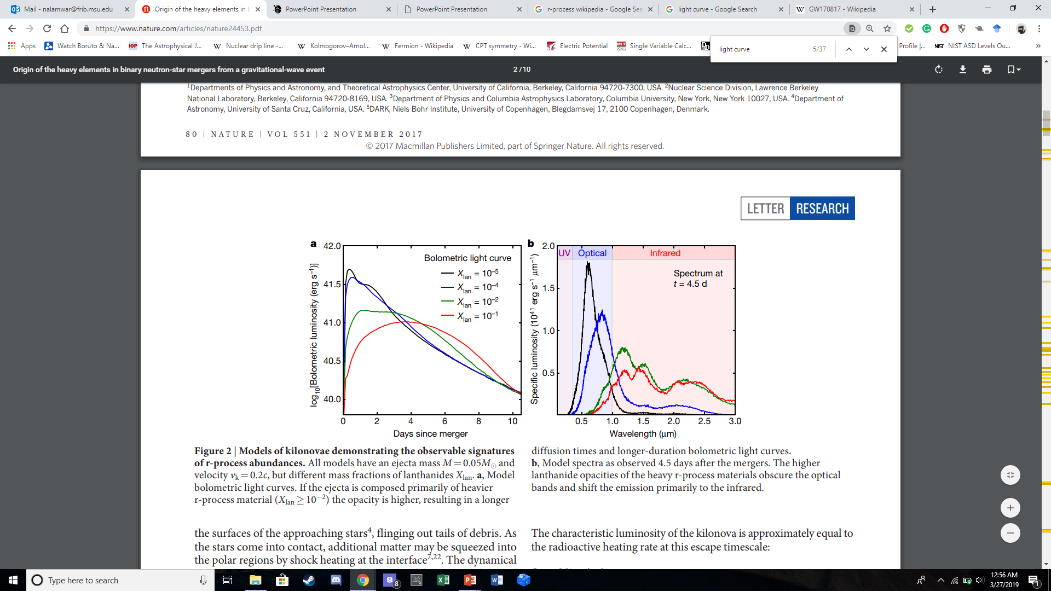
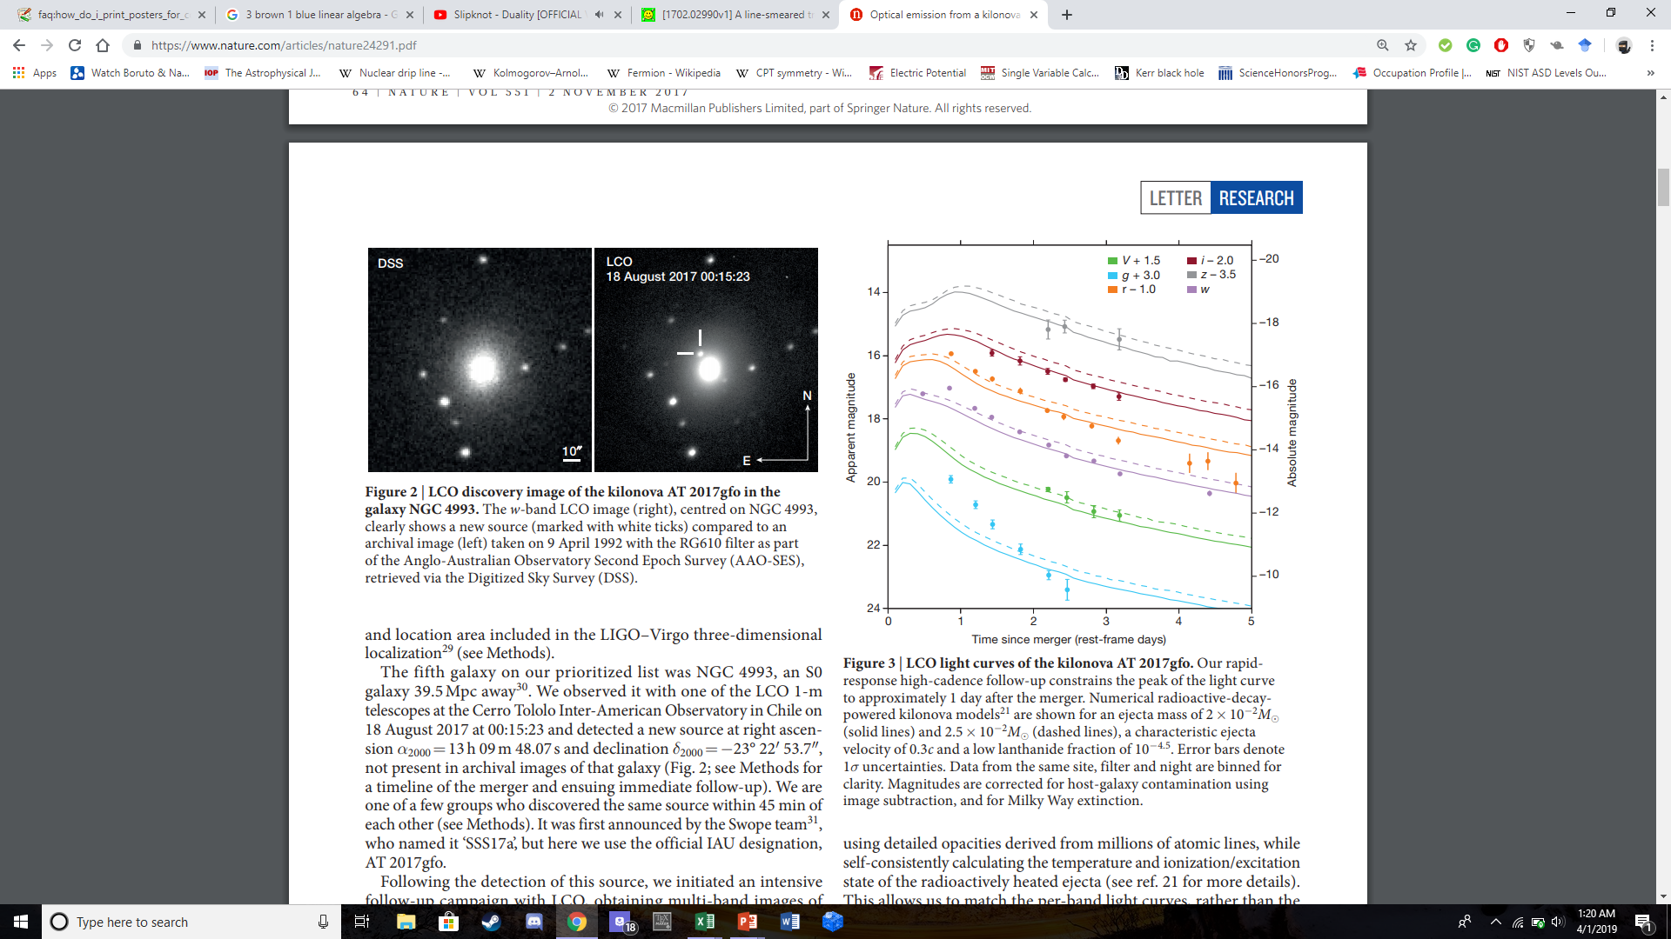
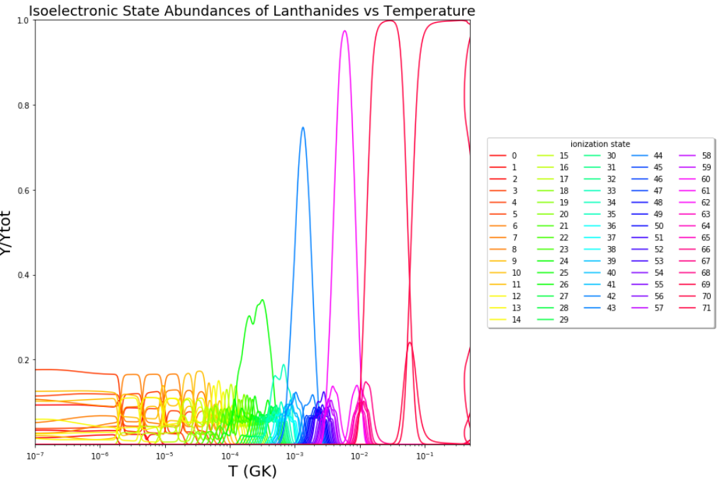
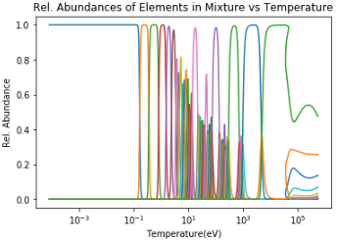
Lanthanide Database for Abundances in Neutron Star Mergers Pranav Nalamwar, Jaideep Singh, Luke Roberts
1 Department of Physics, Michigan State University, East Lansing, MI, 48823, USA.
2 JINA-CEE, Michigan State University, East Lansing, MI, 48823, USA.
_{Origin of the Heavy Elements}
Big Bang Nucleosynthesis, or the synthesis of the elements specifically after the Big Bang, involved the creation of helium and lithium atoms through hydrogen atoms. Nuclear fusion in the cores of stars became the prime process used to form the elements up to iron. Supernovae, or the violent explosions marking the deaths of these stars, formed quite a few of the heavier elements through the rapid neutron capture process, or r-process. Atoms capture neutrons in a neutron-rich environment, creating a radioactive isotope that later decays into stable ones. However, a new class of astronomical event seems to be the source of the remaining r-process elements: neutron star mergers. These neutron star mergers(NSMs) are often the most neutron-rich events in the universe, so they are necessary for the formation of the rather heavy elements, most notably the lanthanides and actinides. Understanding all the details to this event will uncover why there is such a large abundance of elements like gold and uranium. There has been two confirmed NSMs, most notably GW170817 in 2017. This merger also had an associated kilonova, the optical transient. By studying its spectra, one can deduce which elements were created in the merger event as the radioactive and energetic atoms release light that all contribute to this observed spectra.
Figure 1: Periodic table of the elements color coded by the element source. Note the trend where most of the elements,
starting from Sr to Pu, are mainly created by neutron star mergers. Other contributions come from supernovae.
_{Motivation}
Comprehension of how the r-process works in neutron star mergers is key to understanding the origin of the heavy elements. Now, we don’t simply want to understand which elements have the largest abundances produced in these mergers. Instead, we wish to look at which ionization states, charge states, and isoelectronic states of which elements dominate the merger mixture at late times. At these times between 1 hour to 2 weeks after the merger, many of the newly formed isotopes wouldn’t decay, thus contributing both to the spectra observed and the overall abundance of the heavy elements. By studying these r-process elements’ abundances, we can create a useful database of the most important ionization states. This database would be useful for Astronomers as they would know exactly which aspect of the spectra to examine and thus confirm which elements formed in the material. The kilonova light curve for GW170817 is rather detailed and there is much data on it, but due to the numerous amount of lines present, it is unrealistic to account for every element’s spectral lines. Therefore, the Atomic Physics behind several ionization states must be accounted for, which means the transition energies and the energy levels are of high importance.
_{Methodology and Procedure}
Skynet, a nuclear reaction network code developed by Jonas Lippuner and Luke Roberts, was utilized to output all the elemental abundances for hydrogen all the way to elements beyond oganesson. The Saha equation is utilized here since there is a useful relationship between the nth and (n+1)th ionization states. However, since we didn't ‘t have access to any specific ionization state or any free electron fraction values across time, we developed numerous equations relating the elemental abundances to each ionization state abundance. Using these equations, we built three abundance functions: the first used only one element, samarium, to calculate the abundances across all 63 ionization states while the second involved two elements, samarium and europium. The final code simply requires the user to input any number of elements they want and which ones to consider. An important idea to note is that the abundance calculation code only utilizes data for elements 1 to 103 since we are focused on the lanthanides and actinides only. Also, the NIST table has numerous gaps in their database of ionization potentials for any element heavier than lawrencium.
_{Results and Analysis}
Our calculations yielded abundances of all ionization states for all elements between Hydrogen and Lawrencium inclusive. For all elements, the abundances for late times after approximately 10-4 _{sec or below 10}¹ eV are all 0 besides the charge neutral state. For early times, so for temperatures larger than 104 _{eV or before 10}-2 sec, the abundances for most ionization states of any element are 0 except for the much more energetic charge states and the fully ionized ones. Note that all the abundances should be 0 besides the fully ionized one at early times but we did not account for electron degeneracy in the mixture. The free and bound electron fractions are calculated independent to Skynet output and contribute to the trends of the total electron fraction. The electron fraction is one of the important aspects of the Saha equation since it is an indicator of how the electrons are distributed in the medium. It affects how abundant certain charge states can be. All the elements’ charge state abundances follow the same pattern: as the energy of the system decreases, a given charge state becomes less dominant at the same time the lower charge states become significant, thus producing these peaks of the abundances. In fact, the crossing where the dominant species changes is approximately where the transition energy occurs.
_{Conclusion}
Based on our analysis of the abundance graphs
Equation 1: The Saha equation (top) is the backbone of all the ionization state abundance calculations. Y_{Z,I+1}/Y_{Z} refers to the ratio of the Z+1 ionization state abundance to the Zth ionization state abundance. Y_{e,tot} is the total electron fraction of the merger material, f is the proportion of the Y_{e} that is free, and χ_{i} is the ionization potential of the ith ionization state
Figure 4: Plot of samarium abundance over time (left) based on output from Skynet. Note that the abundances at early times is noise considering there are values lower than 10⁻²⁰. Values become important around 10⁻¹ sec.
Figure 2: This light curve by Kasen et al. depicts the changes in the amount of light emitted by the ejecta mass, each with different fractions of lanthanides.
Figure 3: Arcavi et al^{3 ‘}s light curve depicts how the brightness of the light observed decreases as a function of time. The light curve differs substantially compared to the model by Kasen et al.
Figure 5: Relative abundance graph of Samarium(Z=62) as a function of temperature in the merger material. It is relative to the total abundance of the element at any given time. The numerous colors represent the different ionization state abundances, where the blue at low temperatures/late times is for the fully neutral state.
Figure 6: Relative abundance graph of all the lanthanides’ isoelectronic state abundances as a function of temperature in the merger material. The various colors represent the unique isoelectronic states and the first 10 to 12 isoelectronic states are dominant at cool temperatures.

